Slide 1

Year 11 Information Evening
Tuesday 23 November

Slide 2

Introduction
Mr Wilson – Assistant Headteacher

Slide 3

The Road Ahead
29th November – Mock Exam Fortnight
15th December – Post 16 Application Deadline
7th January – Year 11 Reports
10th January – Creative iMedia Exam
11th & 13th January - Parents’ Evening
23rd February – English Macbeth Assessment
3rd & 10th March – Food Practical Exam
Date TBC (March) Drama Component 2
24th March - Y11 Reports
Date TBC (Easter) – MFL Speaking Exams
4th April - English Language Paper 1 Section A
Date TBC (April/May) - GCSE PE Practical Moderation
16th May – Summer Exams Begin
29th June – Summer Exams End
Date TBC (July) – Prom
25th August – Results Day

Slide 4
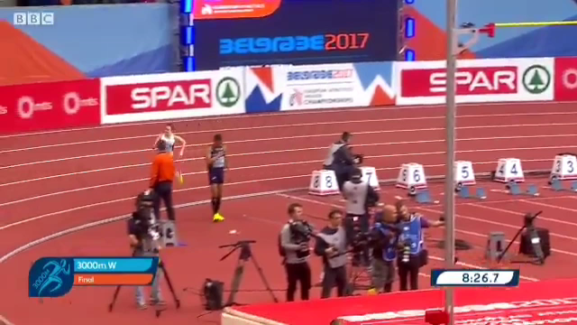

Slide 5
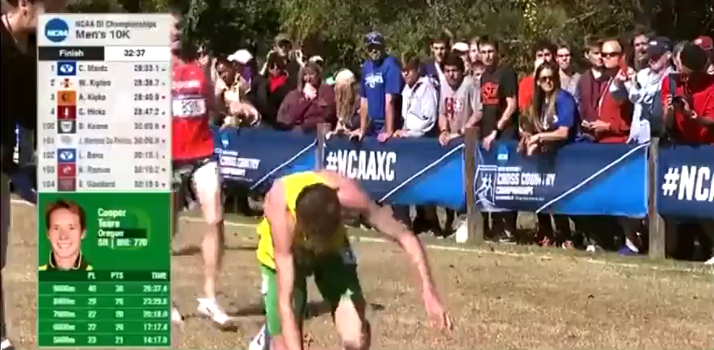

Slide 6






Slide 7
Ex-Students
Jo Cook & Erin McManus

Slide 8

Mocks, Revision, Homework & Reports
Mr Allard - Assistant Headteacher

Slide 9

Practice Exams
All year 11 students taking 2 weeks of practice exams to help them prepare for the real sessions coming in June
Students have received full instructions on how to prepare and conduct themselves in the exams.
Currently, we expect exams to go ahead in June, but should they be cancelled again, we would be using the results from the practice exams as part of our evidence.
Curriculum is being adapted and fully covered

Slide 10

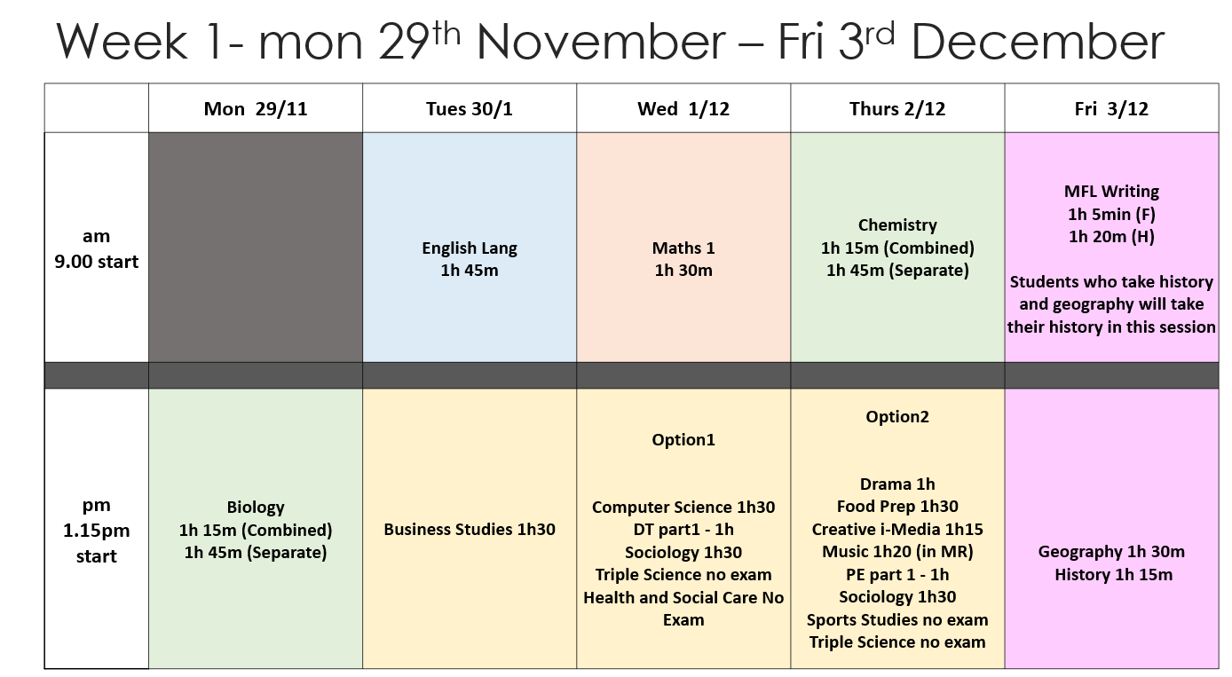

Slide 11
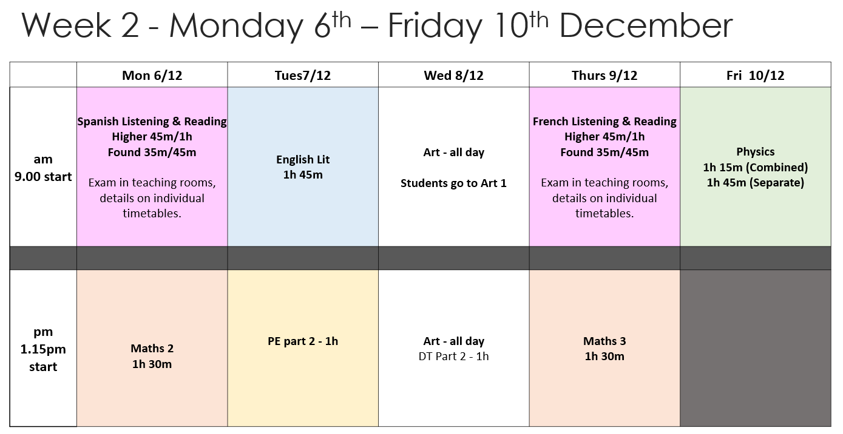

Slide 12
Revision for finals
GCSE exams start officially on Monday May 16th.
Most exams will be completed in a four week period with a half term break in the middle.
Exams should be completed by Wednesday 29th June.
Regular review in classes, and a number of after school sessions running

Slide 13
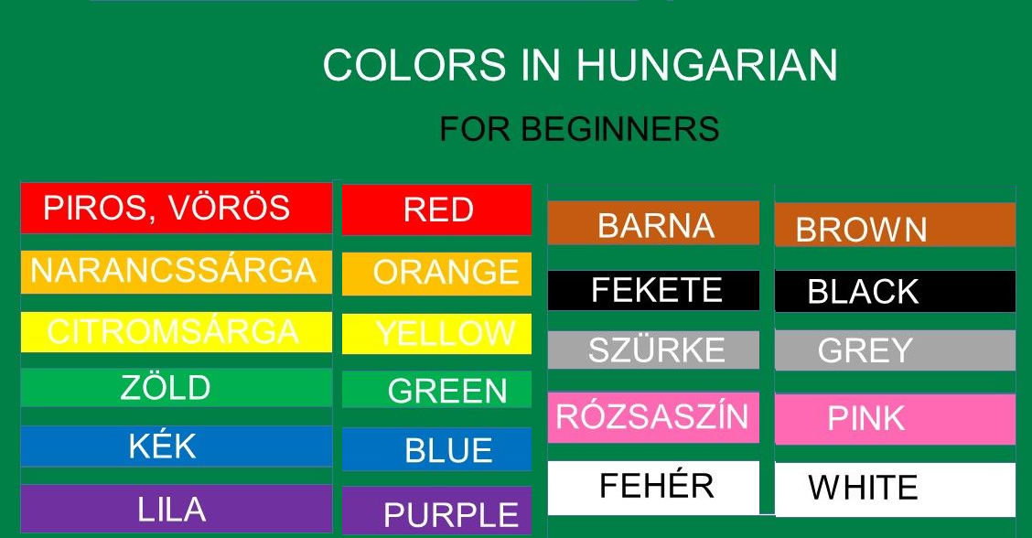

Slide 14

How to support your child’s revision
Support them in planning. We teach students how to write a plan for use at home, and you can support this. This plan needs to be:
Realistic - students will have had full days at school, and they need to not try to do too much in any night.
Varied - 20 minutes on three subjects is much more useful than an hour on one
Planned Teachers will share a general revision plan and students should organise their revision timetable around this.
Visible Make sure a copy of the revision timetable is somewhere where everyone can see it.
Flexible No panicking if a day get’s missed, just carry on.

Slide 15
How to support your child’s revision
Ensure they have the right conditions. To revise effectively, they need to be away from distractions, and be staying healthy and fit.
Ensure no phones or screen are accessible whilst revising.
Avoid music. It doesn't help (even though most students believe that they revise better with music playing)
A good healthy meal in the evening, and sensible bedtimes.
Some activity (preferably physical) that is nothing to do with school as a break and reward.

Slide 16
How to support your child’s revision
Encourage the right techniques. There are good ways and bad ways of revising. These apply to pretty much everybody.
Good ways include flashcards, mind-maps (without the notes) practice questions, verbal summarising and trying to teach someone else
Bad ways include lots of note taking, reading large amounts of the text book, and highlighting passages.
As a general rule, they should always start by trying to remember the ideas, then check and re-learn if they need to.

Slide 18
How to support your child’s revision
Test them. Even if you have no knowledge of the subject, there are ways of helping without this being too onerous for yourself or your son/daughter. For example:
  Ask them to summarise what they have done that day. This act of summarising will actually help them to learn it better, as they are having to recall the information.
  If they are writing flashcards, you can use those to quiz them.
  If they are using a revision guide, these often have questions you could use.

Slide 19
Homework at Gartree
What to expect and how to check

Slide 20

Purpose of homework
Revise and review ideas from the lesson
Practice techniques and skills
Allow pupils to explore subjects more broadly
Help students and teachers identify weak areas to revisit
Help students develop self-management skills
NOT
To keep pupils busy
To finish off work
‘Go away and find out’

Slide 21

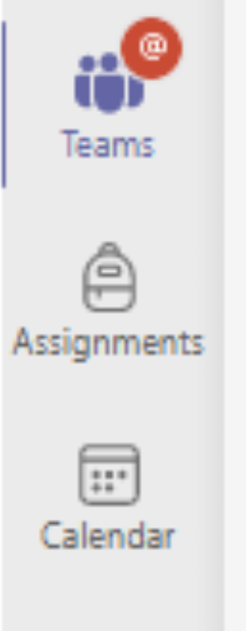
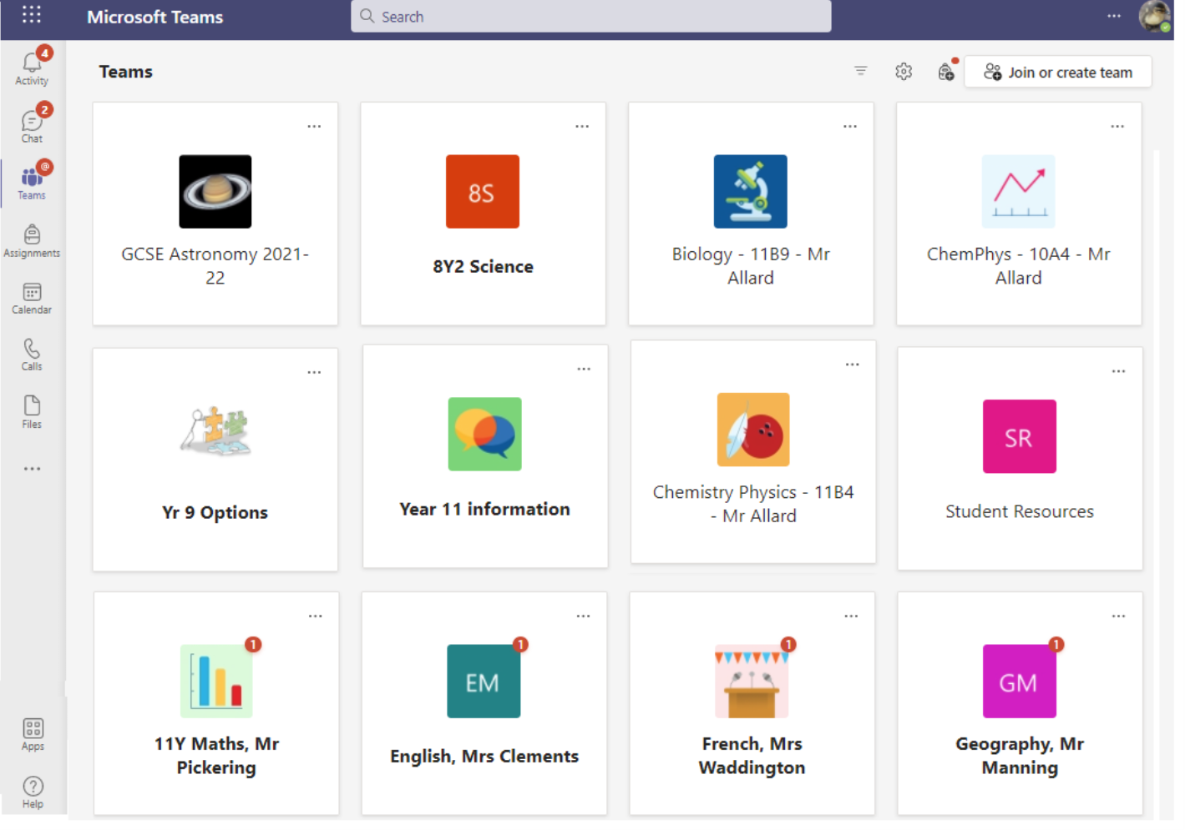


How to check what homework your child has

Slide 22
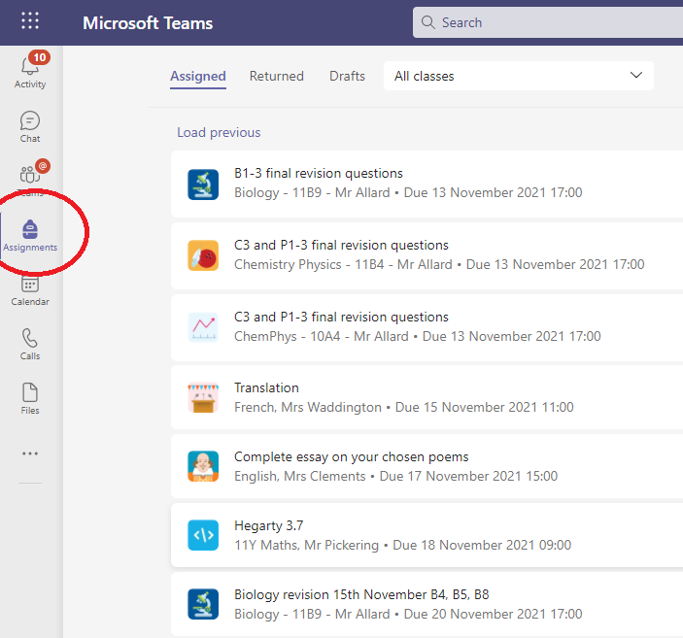
‘Assignments’ lets you see all current and past homework in list form

Slide 23
Calendar view shows deadlines in a week-to-view format

Slide 24
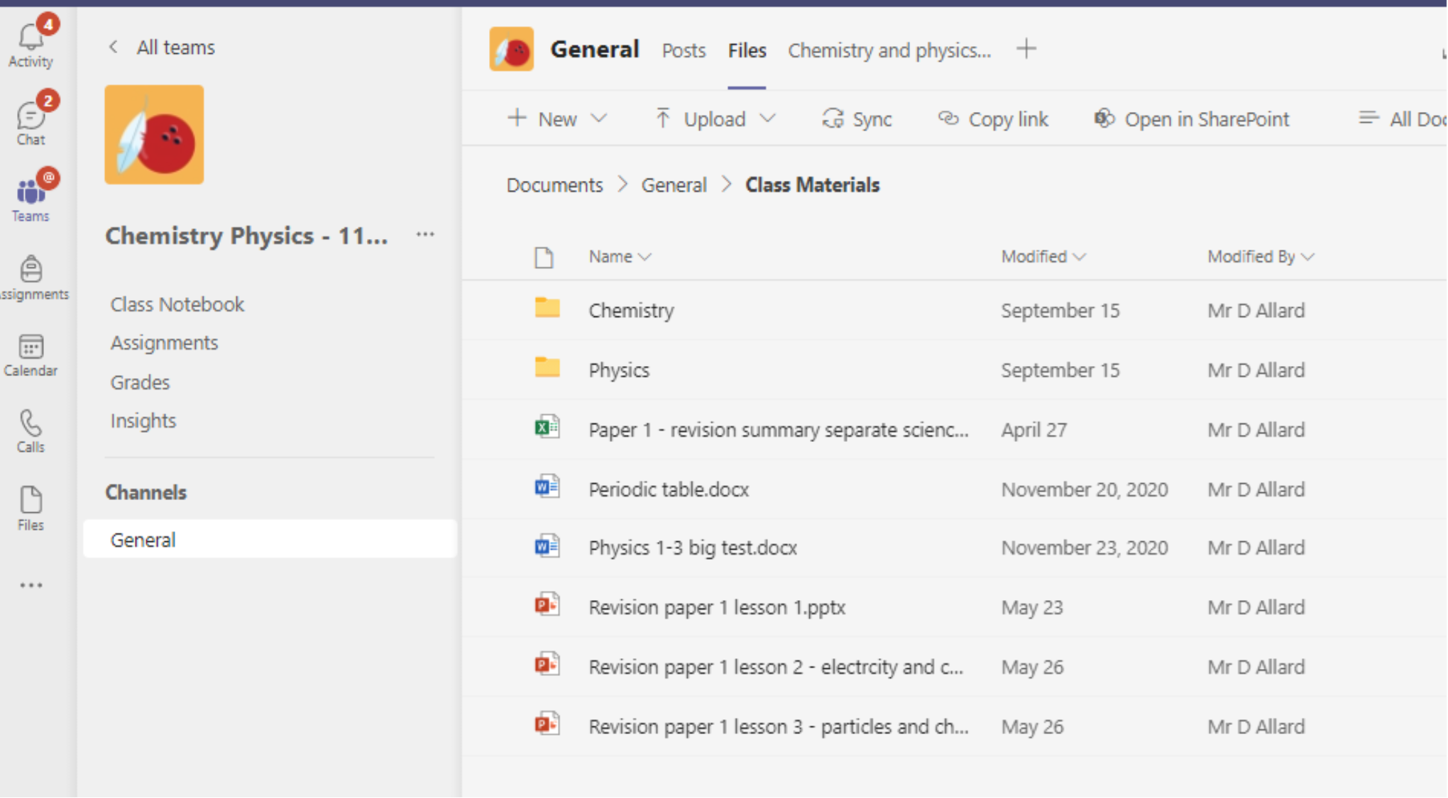

Slide 25

Reports
You will receive a report early in the new year.
This will contain indicator grades (GIGs), Teacher assessments and the practice exam grades.
You are welcome to contact teachers or form tutors if you have specific concerns at this stage.

Slide 26

Post 16

Slide 27



Post 16 Applications
September – Introduction to Post 16 courses and colleges, writing of personal statements
October – Logging on to PS16 website, College Open Days
November – Completing Open Days, Completing Applications
December – “Tidy Up”, References Begin (Mock Examinations)
January – References Completed, Qualifications Added
March – Interviews Begin

Slide 28


Post 16 Applications
Questions/Concerns
I’m worried about my personal statement
I’m still not sure which college or which courses to apply for
I need more info on courses
I’m not sure how to send off my application
I’ve applied but changed my mind about something

Slide 29

Wellbeing & General Tips

Slide 30

Wellbeing – Sources of Support
Parents, Family & Friends
Pastoral Support
School Counsellor
Wellbeing Workshop(s)
External Agencies
Websites & Helplines
GP and Specialist Services

Slide 31


Wellbeing – Top Tips
1. Balance

Slide 32
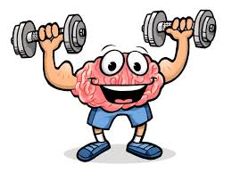
Wellbeing – Top Tips
2. Exercise

Slide 33
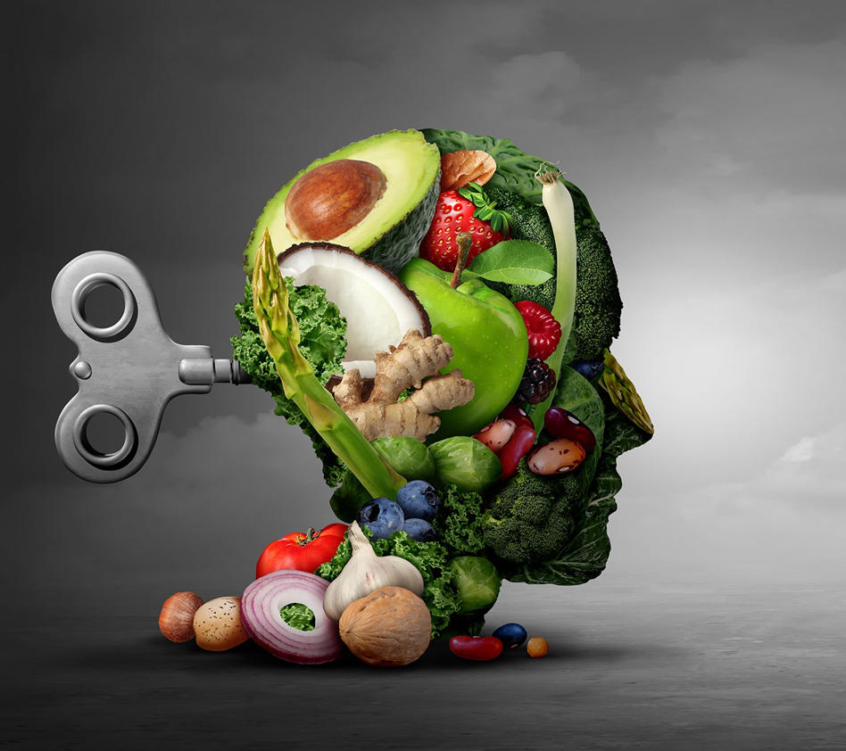
Wellbeing – Top Tips
3. Diet

Slide 34
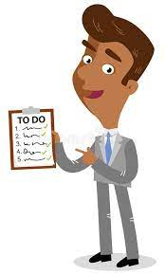
Wellbeing – Top Tips
4. Organisation

Slide 35
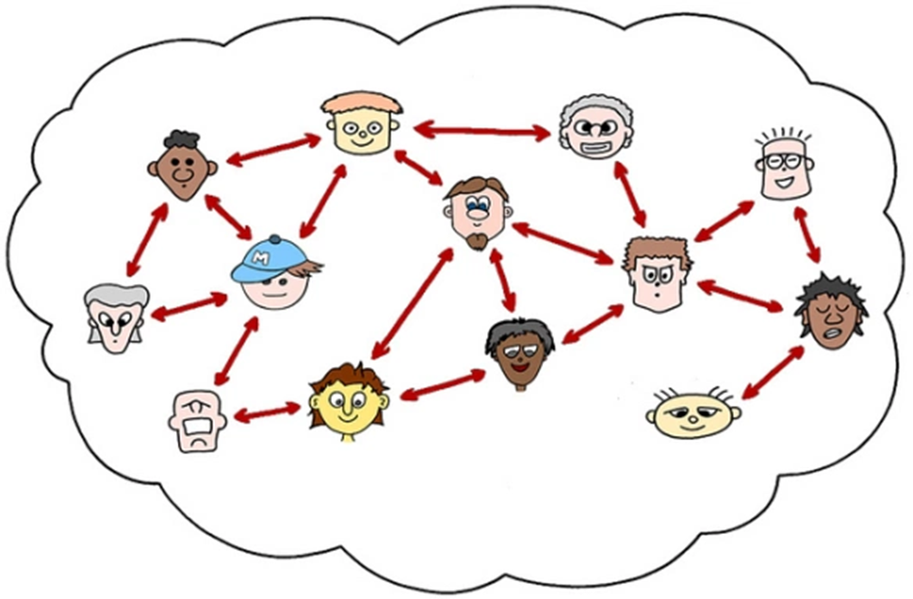
Wellbeing – Top Tips
5. Connecting

Slide 36

Wellbeing – Top Tips
Bonus Tip - Perspective

Slide 37

Tips For Parents & Carers
1. Support the wellbeing tips
2. Provide the resources & environment
3. Monitor & motivate
4. Follow the 80-20 rule
5. Reward them
6. Spot the stressors

Slide 38

Tips For Parents & Carers
Gartree High School on Vimeo

Slide 39


Thank you for listening.
Have a good evening.

